Slide 1
REST API
Fundamentals
learn more

Slide 2
HTTP Headers
Content-Type
Accept
The Content-Type entity-header field indicates the media type of the entity-body sent to the recipient. (request)
The Accept request-header field can be used to specify certain media types which are acceptable for the response.

Slide 3
HTTP Methods (CRUD)
1
2
3
4
5
GET
POST
DELETE
PUT
PATCH
Retrieve resource information
(READ)
Create new subordinate resources
(CREATE)
delete resources
(DELETE)
primarily to update existing resource
(REPLACE)
make partial update on a resource
(UPDATE)

Slide 4

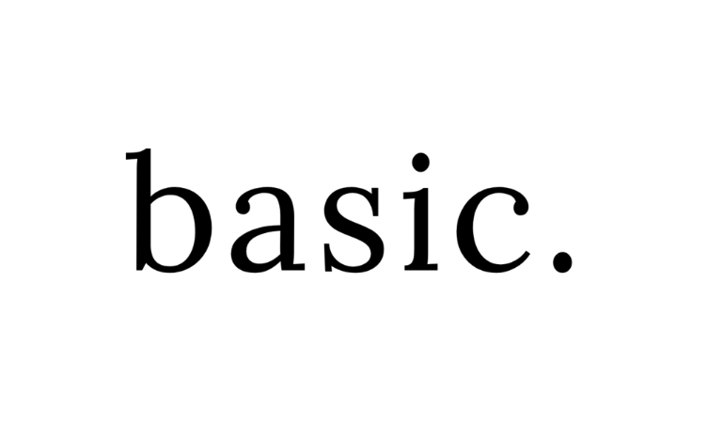

Authentication
No Authentication
Basic
OAuth 2.0
Token
Examples: Weather Forecast, Google Map
Examples: ServiceNow,
JIRA
Examples: Payment Gateways, ServiceNow
Examples: Oracle WMS,
JWT

Slide 5
Request Parameters – Data Types
These data types are the most common with REST APIs:
string: An alphanumeric sequence of letters and/or numbers
integer: A whole number — can be positive or negative
boolean: true or false value
object: Key-value pairs in JSON format
array: A list of values
Header
Query
Form
Path

Slide 6
Body (Contents)
The body can have different formats like below:
JSON
01
JSON - JavaScript Object Notation
XML - Extensible Markup Language
TXT – Plain text format
TXT
XML
03
02

Slide 7
JSON Structure
Simple JSON format
Simple JSON Array
{
“name”: "Babu",
“age”: 45,
“city”: "Chennai"
}
{
“name”: "Babu",
“age”: 45,
“companies”: ["Syntel", "HCL", "HP", "TL"]
}

Slide 8
JSON Nested Arrays
{
"name":"Babu",
"age":45,
"companies":[
{"name" : "syntel", "years" : "3.1", "customers" : 4, "country" : ["india", "usa"]},
{"name" : "hcl", "years" : "1", "customers" : 1, "country" : ["india"]},
{"name" : "hp", "years" : "13.2", "customers" : 18, "country" : ["india", "usa","uk","sg"]},
{"name" : "tl", "years" : "4.3", "customers" : 8, "country" : ["india", "usa"]}
]
}

Slide 9

Status Codes
100 -199
200 - 299
300 - 399
400 - 499
500 - 599
Information
Success
Redirects
Clients Errors
Server Errors

Slide 10
Thank You!

